Slide 1


An Environmental Genomics Data Jamboree Review
George Melrose – 2244870

Slide 2
Research Goals & Tools
Principal Component Analysis (PCA), Weighted gene co-expression network analysis (WGCNA) , Cytoscape, Panther
RNA-Seq data, Sample Sheet list , Ortholog Mapping data
(1) How do biological features change between different sample extraction sites and concentration levels?
(2) How do above changes relate to detected individual chemical compound distribution? Which chemicals can be harmful to Daphnia?
(3) What biological insights can be gained throughout the investigation?
RNA-Seq & Metabolomics data
Regularized and Sparse Generalized Canonical Correlation Analysis (RGCCA), background literature

Slide 3
PCA – Reducing dimensionality, finding the most important features
+ Reduces Overfitting - Reduces the no. variables when there are too many.
+ Improves algorithm performance – Fewer correlated variables are left so training time is reduced.
+ Improves data visualisation – The low dimensional nature of PCA means it can be visualised easily.
Information loss – The principal components may in fact miss some information from the original list of features.
Unsupervised learning technique – Less accurate results as input data is unknown, with outliers causing variable results.

Slide 4
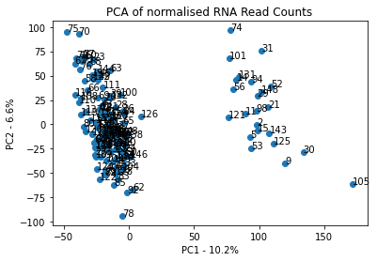
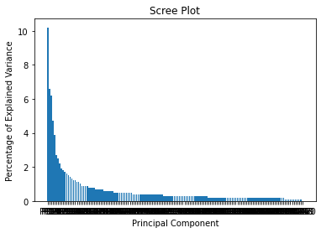
PCA – Unsuccessful on a noisy dataset

Slide 5
WGCNA – Detecting clusters of high correlated genes
The tool allows the measurement of coexpression relationship by using the correlation coefficient of expression between molecules.
Complex data is simplified into several functional modules, associated with phenotypic information (Guillermo Guillen-Gamez et al. ).
Retains network node connectivity unlike unweighted genetic networks.
Powerful analytical efficiency.
Correlation network is based on correlation coefficient and ‘extra’ data like methylation has to be integrated in.
Notes:
- WGCNA is unsupervised

Slide 6
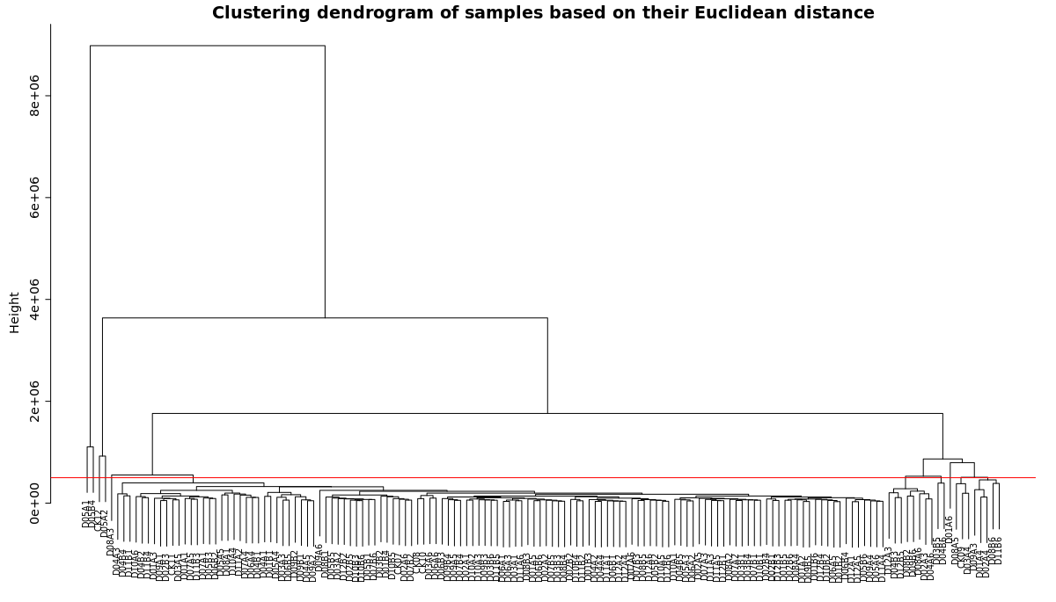
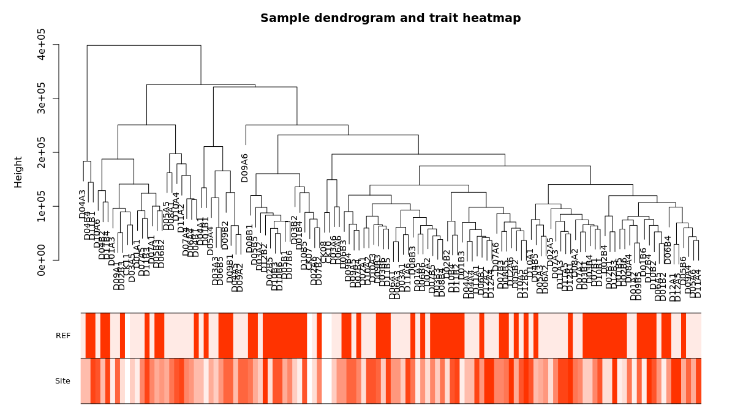
WGCNA Workflow – Part 1 Sample Clustering
Clean data by clustering and removing obvious outlier samples.
Clustering dendrogram of samples based on their Euclidean distance with variables highlighted below to relate to different samples.

Slide 7
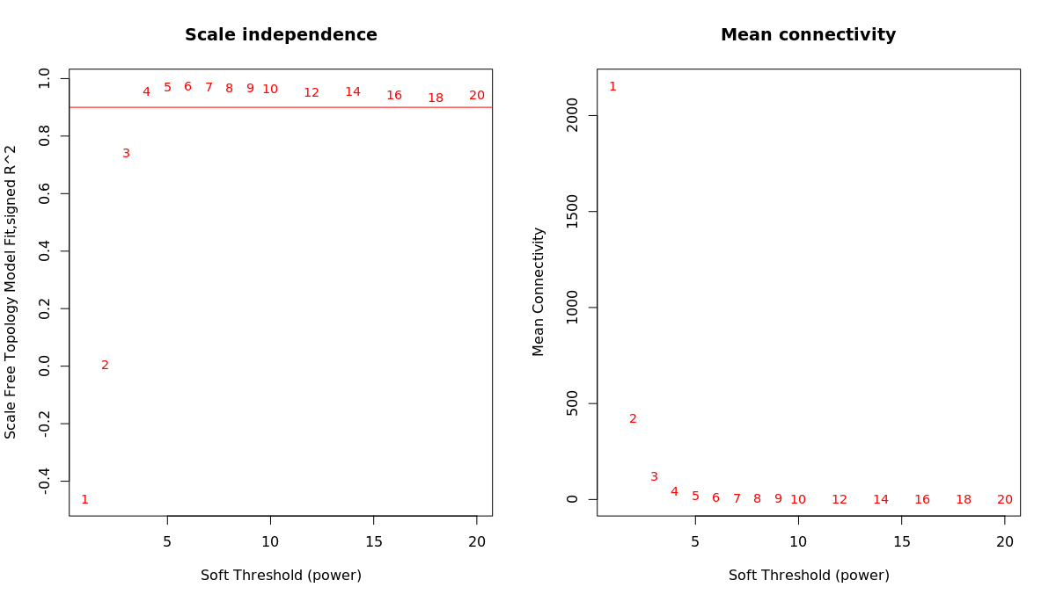
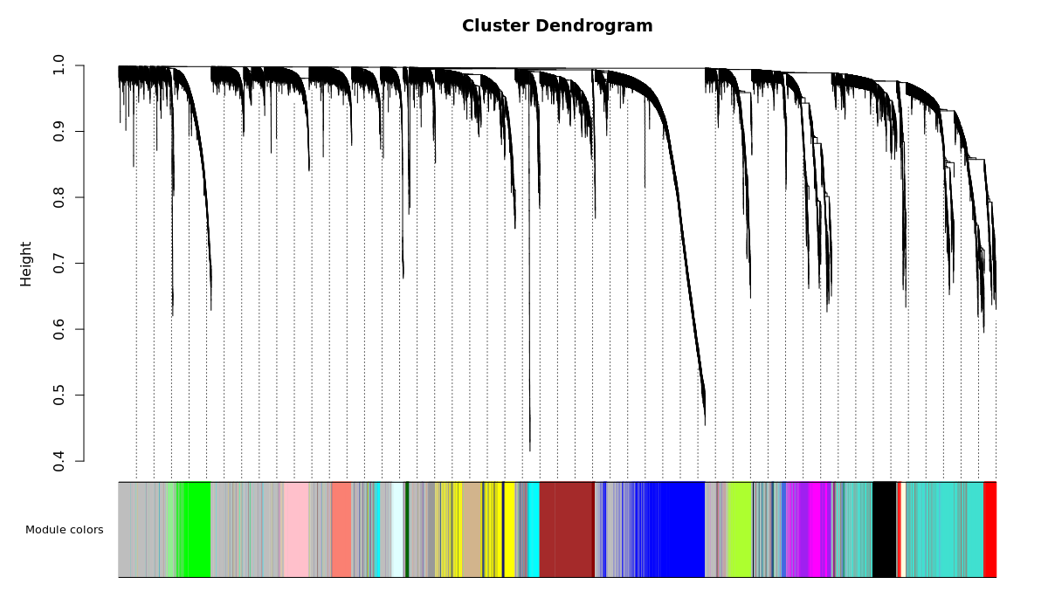
WGCNA Workflow – Part 2 Network topology analysis
Left panel – Scale-free fit index (y-axis) as a function of soft-thresholding power (x-axis).
Right Panel – Mean connectivity (y-axis) as a function of soft-thresholding power (x-axis).
Gene clustering dendrogram. Different module colours are shown and dissimilarity (i.e. how far part apart genes are) is based on topological overlap.

Slide 8
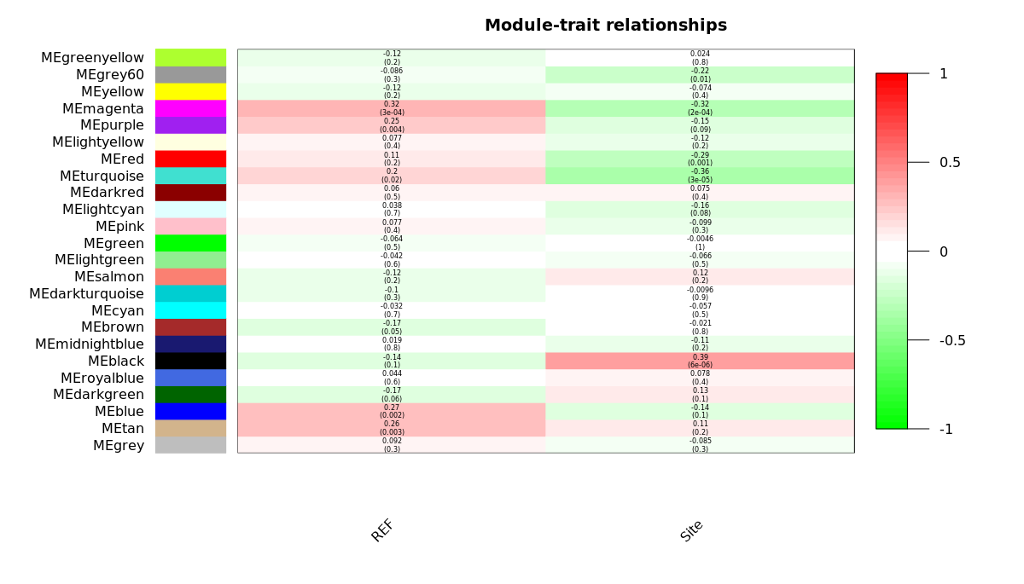
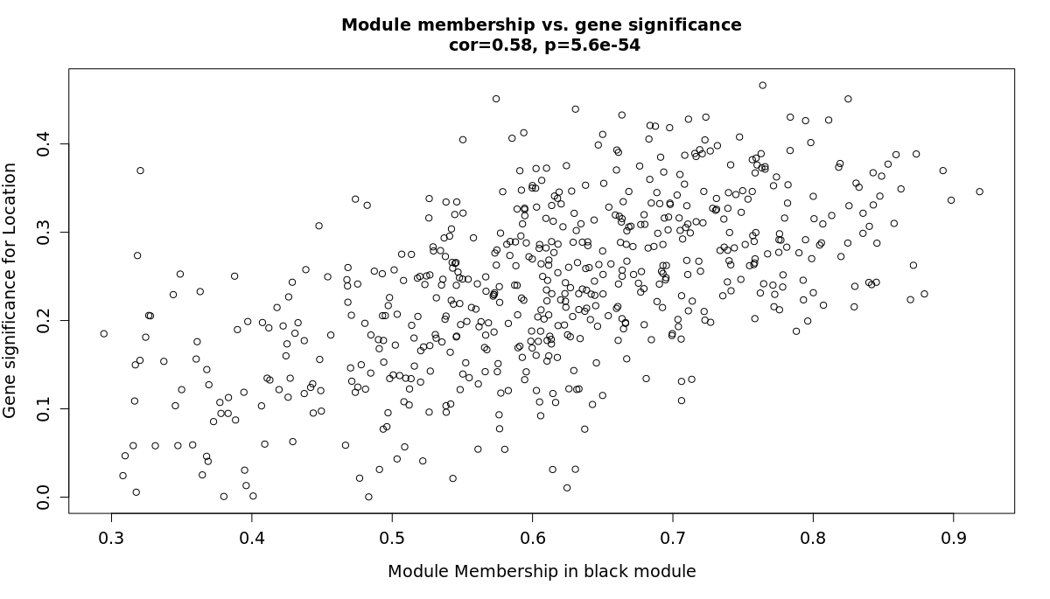
WGCNA Workflow – Part 3 Network topology analysis
Module-trait associations. Each column is a trait/variable and each row a module eigengene. The corresponding correlation and p-value are in each cell. Correlation is colour-coded.
Gene significance for site vs module membership in the black module. There’s high correlation.

Slide 9
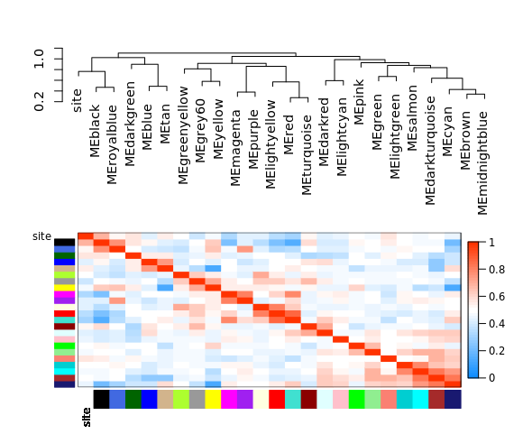
WGCNA Workflow – Part 4 Visualisation – WGCNA functions
Visualising the eigengene network representing relationships among modules and between site modules.

Slide 10
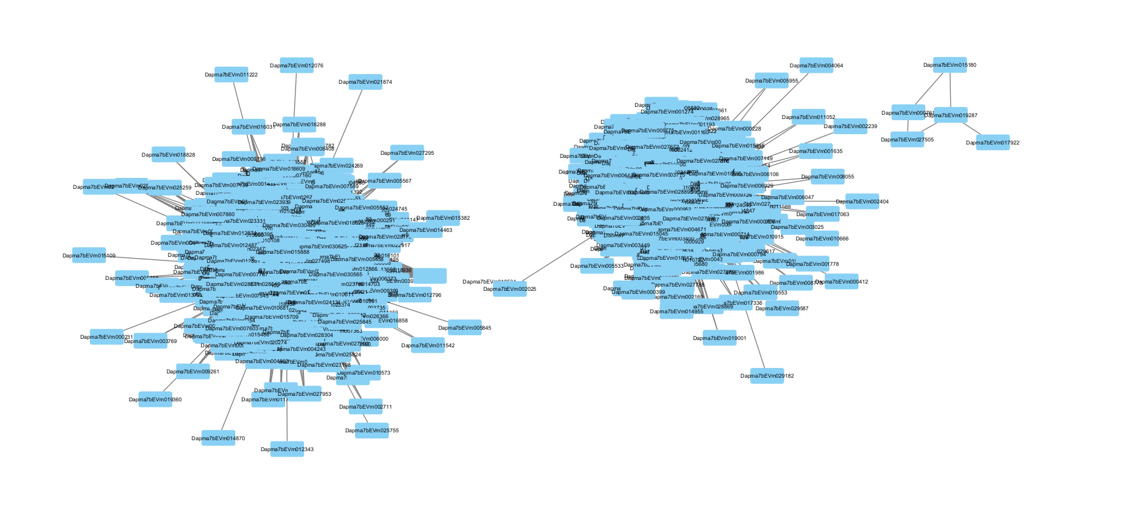
WGCNA Workflow – Part 4 Visualisation – Cytoscape

Slide 11
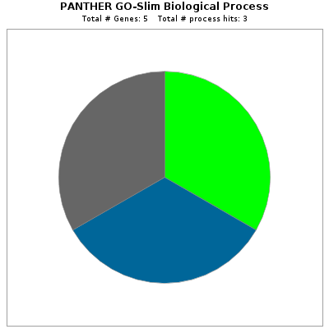
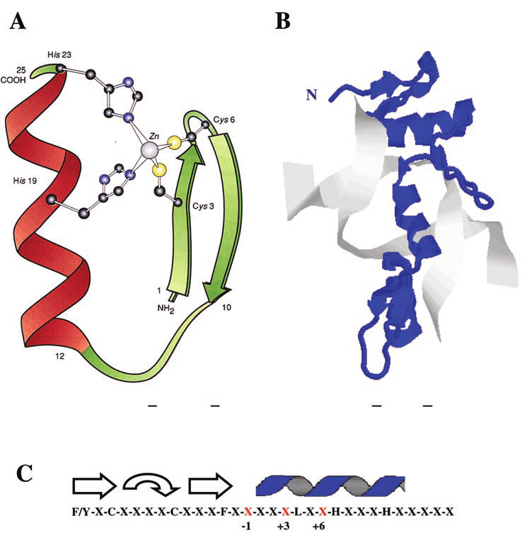
WGCNA Workflow – Part 4 Visualisation – Panther
Adapted from Jheon, 2004.
Biological regulation, cellular process, metabolic process, all hits for one protein - C2H2 zinc finger transcription factor.

Slide 12
RGCCA – Multiblock data analysis
Classic CCA has drawbacks : only apply to be applied to 2 data views; only ID 1D latent vectors; overfits when no.samples is smaller than no.features.
RGCCA (Tenenhaus et al., 2011) maximises the weighted sum of covariances between latent vectors, using a shrinkage factor τ.

Slide 13
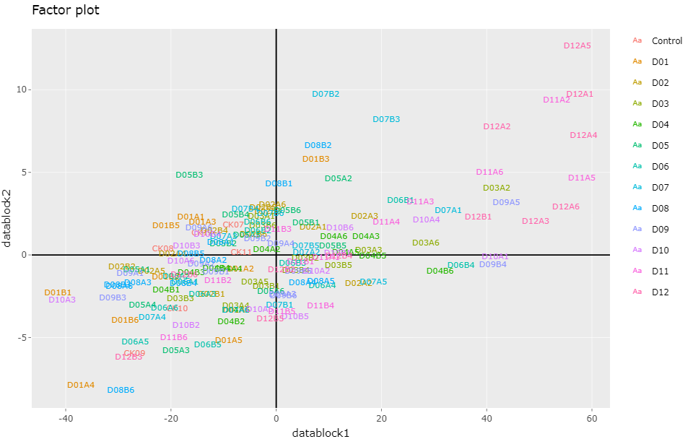

Slide 14
Candidate Chemicals - PPCPs
Carbamazepine (CBZ) – In a study, Daphnia exposed to CBZ has shorter body length and overall growth (Tlan et al., 2019)
n-Acetyl-4-aminoantipyrine – A micropollutant in wastewater, used in a colorimetric method.
Acesulfame – Artificial sweetener, Daphnia severely inhibited above 0.2mg/ml.

Slide 15
Conclusions & Future Directions
A common TF is found to be affected throughout the different locations. Daphnia have been shown to alter gene expression when caloric restriction (Hearn et al., 2020).
A change in C2H2 ZF TF may be related to CBZ exposure…
Studies for ZF TF expression in Daphnia may be warranted – western blots, microarray analysis and RT-PCR.

